Slide 1

HTML Documents

Slide 2
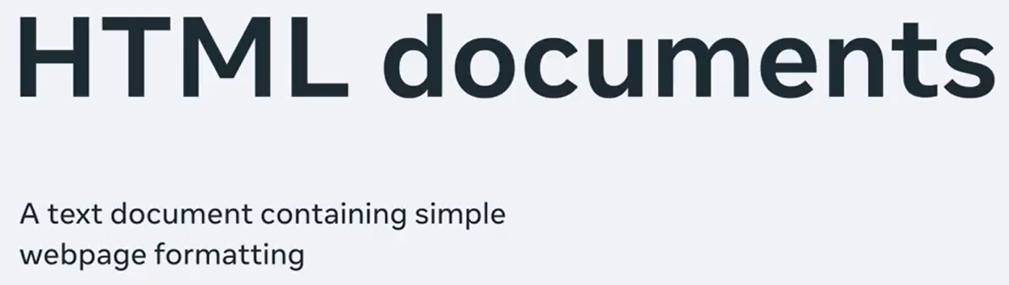
HTML Documents
In this lecture, I will guide you to the blueprints of a HTML document.
I will create a very simple webpage for a restaurant called “Little Lemon”.
The great thing about HTML documents is that you don't need the web to view them.

Slide 3
HTML Documents
Yes, they don't have to be hosted on a web server for you to view them in your web browser.
You can save HTML files on your computer and viewed them locally with your web browser, almost like eating takeaways at home.
By the end of this lecture, you'll be able to identify the structure of a HTML document and create a basic webpage.

Slide 4
HTML Documents
Lets create a very simple webpage for a restaurant.
The great thing about HTML documents is that you don't need the web to view them.
Yes, they don't have to be hosted on a web server for you to view them in your web browser.
You can save HTML files on your computer and view them locally with your web browser, almost like eating takeaways at home.

Slide 5
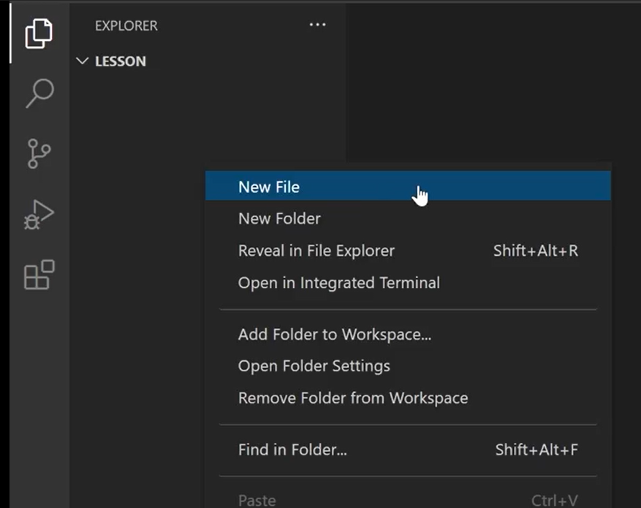
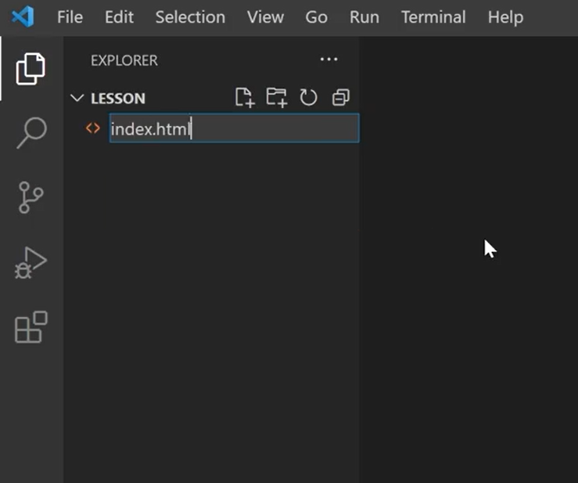
Main File (index.html)
To create a HTML file and Visual Studio Code.
Right-click in the Explorer panel and select New File.
I'll name it index.html.

Slide 6
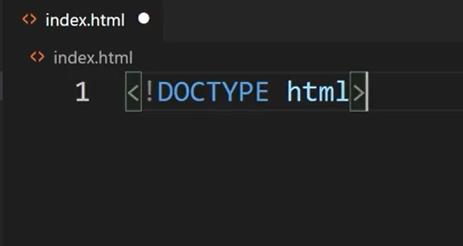
DOCTYPE Tag
By now you know that HTML documents are made up of elements and tags. But before I can add elements or tags, I first need to create a standard HTML structure which starts with the DOCTYPE declaration. This notifies the web browser that it is a HTML documents.

Slide 7
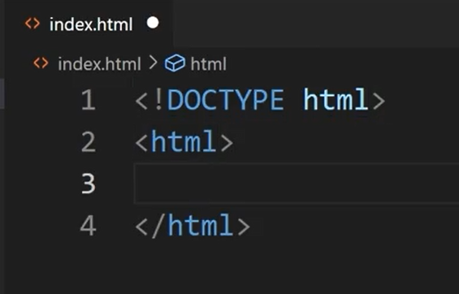
HTML root Element Tag
Next, I create the HTML tag, which is also known as the HTML root element.

Slide 8
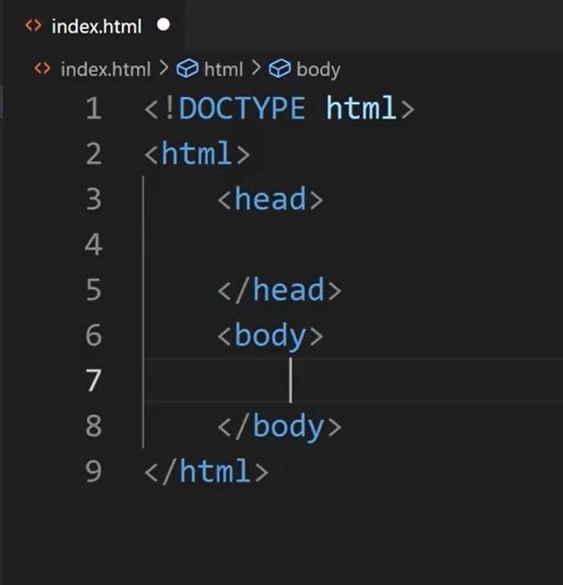
head and body Tags
Inside the HTML tag, I add two main elements, the head and the body elements.

Slide 9
Head Element Tag
It is important to note that nothing inside the head element is displayed on the webpage in the web browser.
In the head element, you add information or metadata about the HTML documents.
It is not part of the content of the webpage.

Slide 10
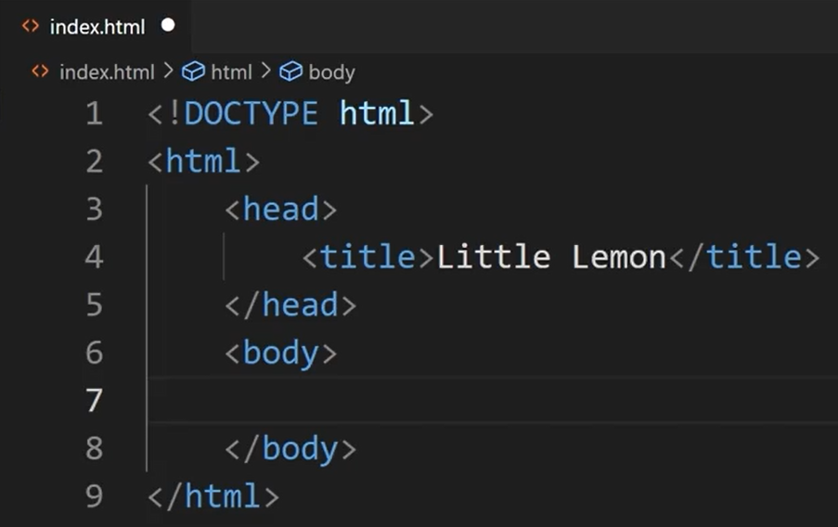
Title Tag in Head Section
For example, inside the head tag, you always create the title elements.
This is the title that is displayed
in the web browser tab.

Slide 11
Linking and Meta Tags in Head Section
I can also link to CSS files and define Meta tags in the head section.
Meta tags can, for instance, specify the description of the web page, keywords for search engines and the order of the web page.

Slide 12
Body Tags
Next up, I add the content of the webpage inside the body tag.
The body can contain elements such as headings, paragraphs, images, and videos.

Slide 13
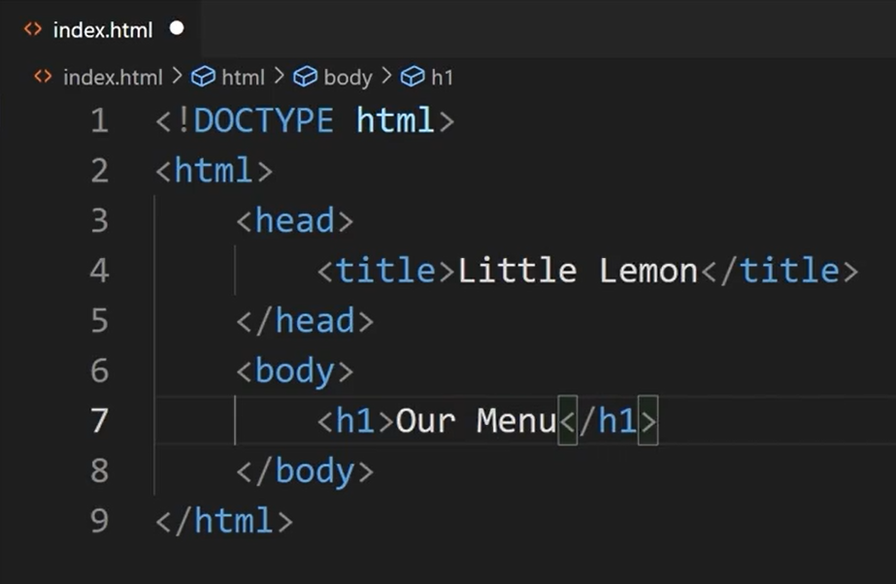
Headings
Let me start by adding a main heading on the webpage by using the H1 tag.
Inside the H1 tag, I typed the
heading, “Our Menu”.

Slide 14
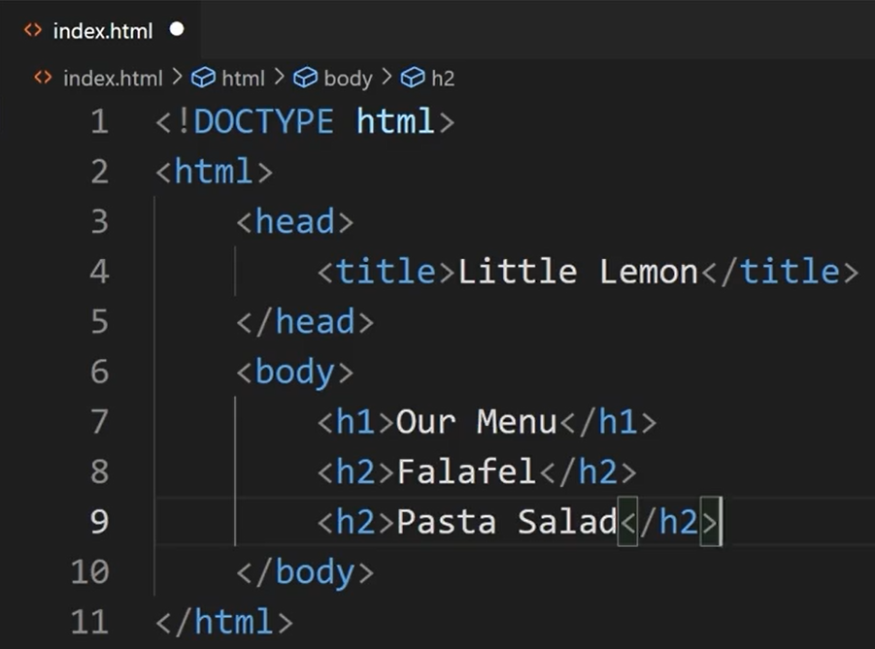
Headings
Now I need to start creating my menu.
I want to add two items. To do that, I add two sub headings.
For this, I use the H2 tag. The menu items
in the sub headings are “falafel” and
“pasta salad”.

Slide 15
Save and View in Browser
In order to make sure everything is correct, I open my “index.html” file in the browser to check my webpage.
But first I need to save the file by pressing the keys Control + S or if you're on a Mac, Command and S.
Now, I right-click on my index.html file in the explorer panel and select “Reveal in File Explorer”.

Slide 16
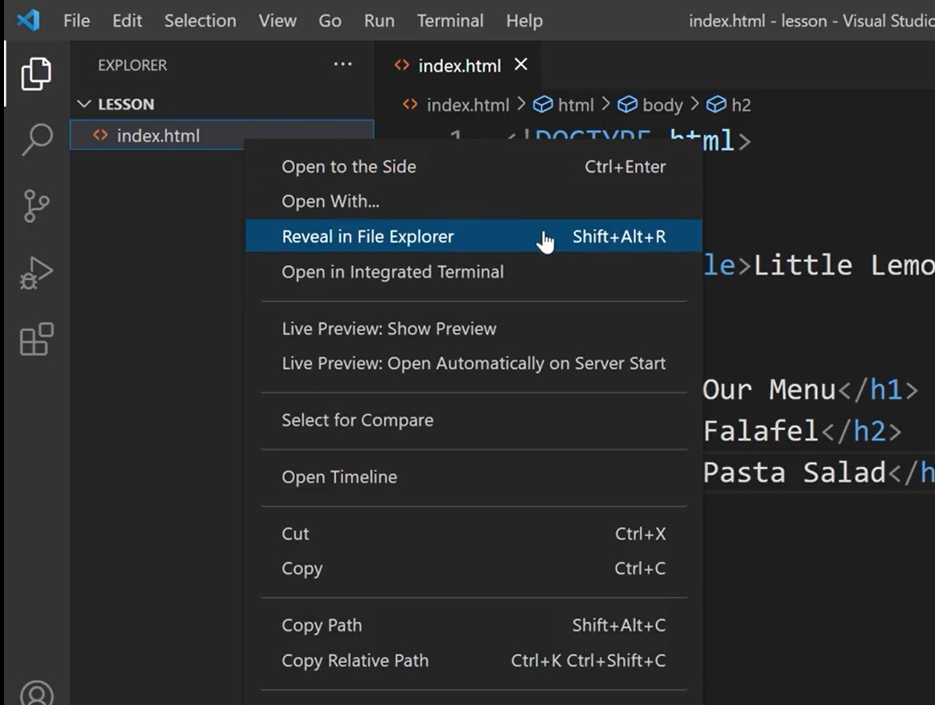
Save and View in Browser

Slide 17
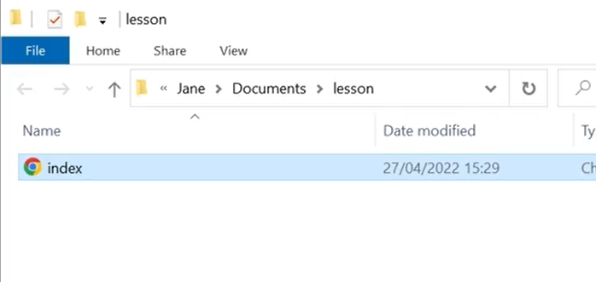
Save and View in Browser
Now the file browser opens and lists the file. I double-click on index.html and it opens in the web browser.

Slide 18
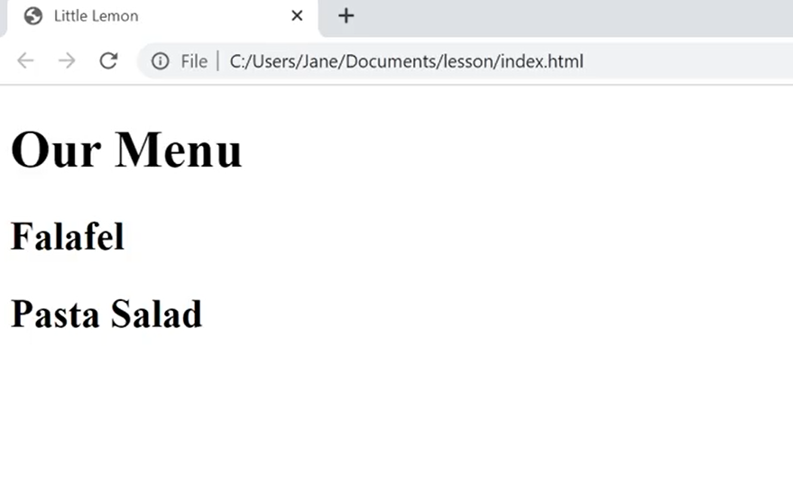
Save and View in Browser
The title that displays in the browser tab matches the title that I added to the head section and the content is displayed in the browser window but it is still a bit empty.

Slide 19
Edit, Save and View in Browser
I go back to Visual Studio Code and add a short description for each dish.
I do this by adding a paragraph <p> tag below each subheading H2.
Let's imagine a nice falafel. I type Chickpea, herbs, and spices.
What goes into the “pasta salad” again? Lettuce, vegetables, and mozzarella.

Slide 20
Edit, Save and View in Browser
I save the file again to update the changes.
Again, I open it in my web browser. There you go.
Now the ingredients are also included in the menu.

Slide 21
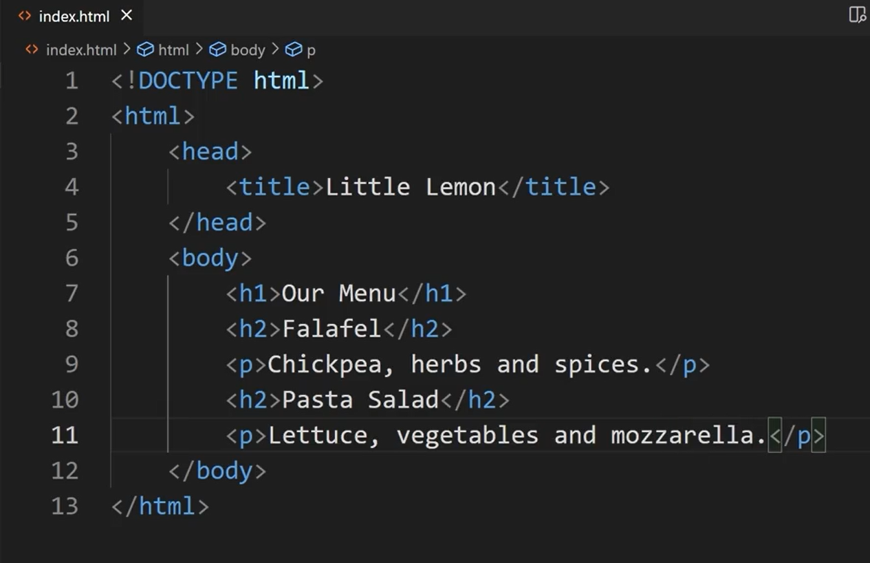
Edit, Save and View in Browser

Slide 22
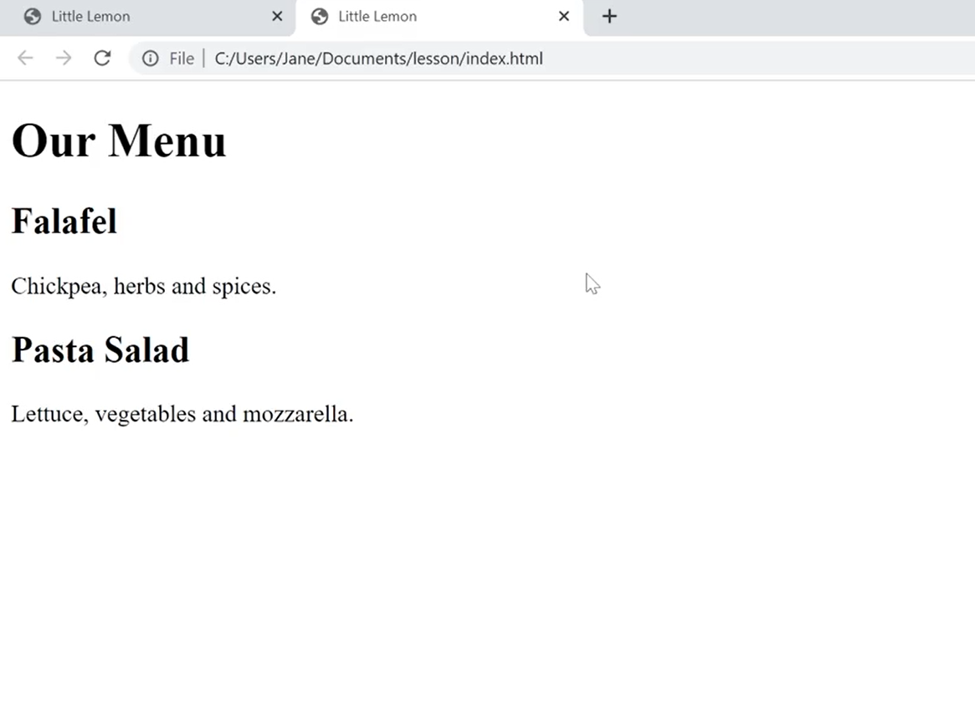
Edit, Save and View in Browser

Slide 23
Additional Resources
Learn more Here is a list of resources that may be helpful as you continue your learning journey.
HTML Elements Reference (Mozilla)
https://developer.mozilla.org/en-US/docs/Web/HTML/Element
The Form Element (Mozilla)
https://developer.mozilla.org/en-US/docs/Web/HTML/Element/form
What is the Document Object Model? (W3C)
https://www.w3.org/TR/WD-DOM/introduction.html
ARIA in HTML (W3C via Github)
https://w3c.github.io/html-aria/
ARIA Authoring Practices (W3C)
https://www.w3.org/TR/wai-aria-practices-1.2/

Slide 24
Thank You

